Slide 1
WDC Basics Future Skills Academy 2017 Viliam Valent Watson iLab developer

Slide 2
Agenda
setup Conversation instance
create intents, entities
create dialog tree utilizing both intents and entities
train classifier
setup UI and orchestration app
create Slack bot
setup orchestration app and install Slack node
create request and response routing to Conversation service

Slide 3
What is Conversation service?
Combines:
machine learning
natural language understanding
integrated dialog tools
to create conversation flows between your apps and your users.
Basic terms
Intent
Entity
Dialog
Context

Slide 4
What is Conversation service?

Slide 5
Intents and entities
purpose or goal expressed in an input
recognizing input => choose the correct dialog flow
represents a class of object or a data type

Slide 6
Dialog
uses the intents and entities
interacts with the user and provides a response

Slide 7
Development
Two options how to use Conversation API:
Curl based API
Download and install programming language API
Node SDK - https://github.com/watson-developer-cloud/node-sdk
Java SDK - https://github.com/watson-developer-cloud/java-sdk
Python SDK - https://github.com/watson-developer-cloud/python-sdk
iOS SDK - https://github.com/watson-developer-cloud/swift-sdk
Unity SDK - https://github.com/watson-developer-cloud/unity-sdk

Slide 8
Node-RED
flow-based programming for the Internet of Things
browser-based editor

Slide 9
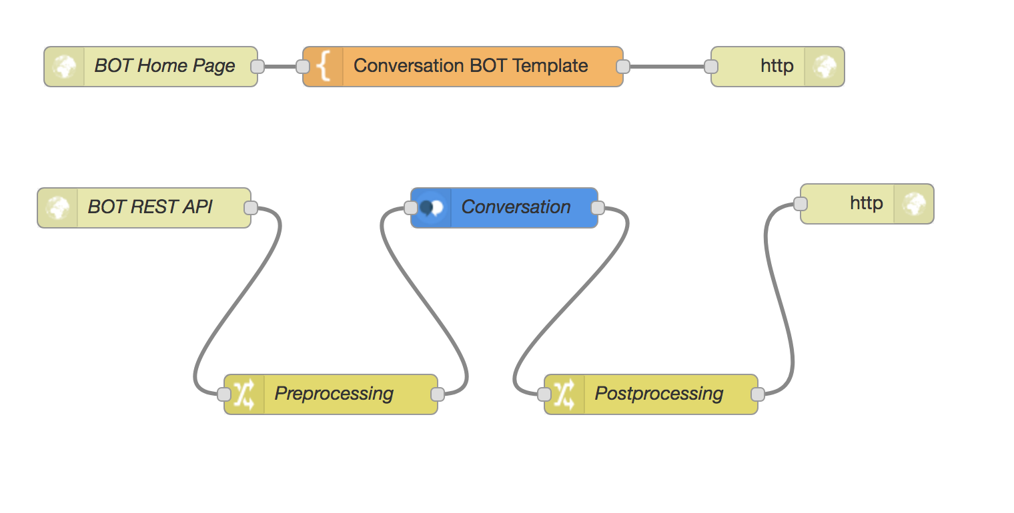
Node-RED
Basic terms
Node
Component
Flow

Slide 10
WDC in Node-RED
example labs on GitHub: https://github.com/watson-developer-cloud/node-red-labs
all APIs as nodes with easy configuration
+ Bluemix = easy credentials management

Slide 11

Slack bot integration

Slide 12
Resources
Documentation: https://www.ibm.com/watson/developercloud/doc/conversation/index.html
API reference: https://www.ibm.com/watson/developercloud/conversation/api/v1/
GitHub with workshop notes: https://github.ibm.com/fsa2017/cognitive-stream

Slide 13
Business Problem – Usecase
Knowledge Management – combining Chatbot with discovery service
Complaint Management – analyzing complaints – using NLU, Discovery Service
eShop Advisor – Use chatbot for receiving customer details
Search for similar things - Visual API – try to find similar Components
Chatbot for querying OSINT – Citizen mood of EU
Visual custom classifier of broken components (controlled by chatbot)
Create Speech to text Advisor to help with abbreviations – for disabled people
Combine Chatbot, Weather, Visual API for various applications

